Slide 2
define the sequence and series,
enlist different types of series,
identify the pattern in the given series.

Slide 3

Sequence
Set of Numbers
Definite Order/Rule
$a_{1}$, $a_{2}$, $a_{3},a_{4}$, ……, $a_{n}$
1, 3, 5, 7, ……, 21 or 2, 4, 6, 8, 10, …..
Finite/Infinite
{$a_{n}$}

Slide 4
Series
Sequence - Numbers
Numbers – Terms
Terms - Predefined Rule
Careful Study
Specific Pattern
Next Term

Slide 5
Types of Series
Number Series
Special Series
Alpha–Numeric Series

Slide 6
Types of Number Series
Arithmetic Series
Arithmetic Series – Second Order
Arithmetic Series – Third Order
Geometric Series
Arithmetico-Geometric Series
Geometrico-Arithmetic Series
Series of Squares, Cubes, …..

Slide 7
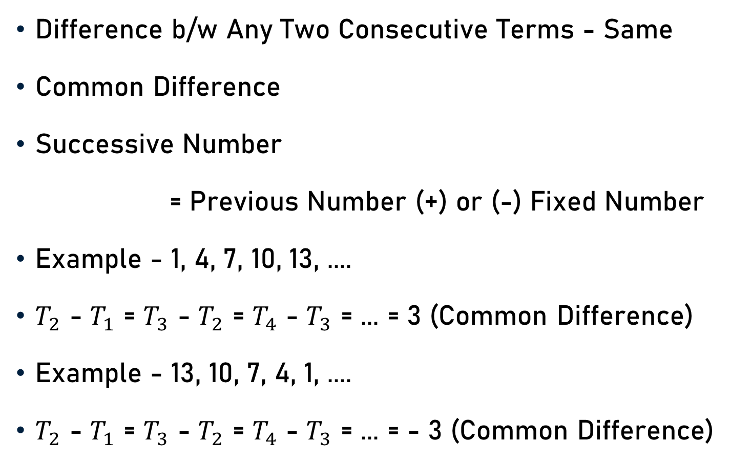
Arithmetic Series
Difference b/w Any Two Consecutive Terms - Same
Common Difference
Successive Number
= Previous Number (+) or (-) Fixed Number
Example - 1, 4, 7, 10, 13, ....
$T_{2}$ - $T_{1}$ = $T_{3}$ - $T_{2}$ = $T_{4}$ - $T_{3}$ = ... = 3 (Common Difference)
Example - 13, 10, 7, 4, 1, ....
$T_{2}$ - $T_{1}$ = $T_{3}$ - $T_{2}$ = $T_{4}$ - $T_{3}$ = ... = - 3 (Common Difference)

Slide 8
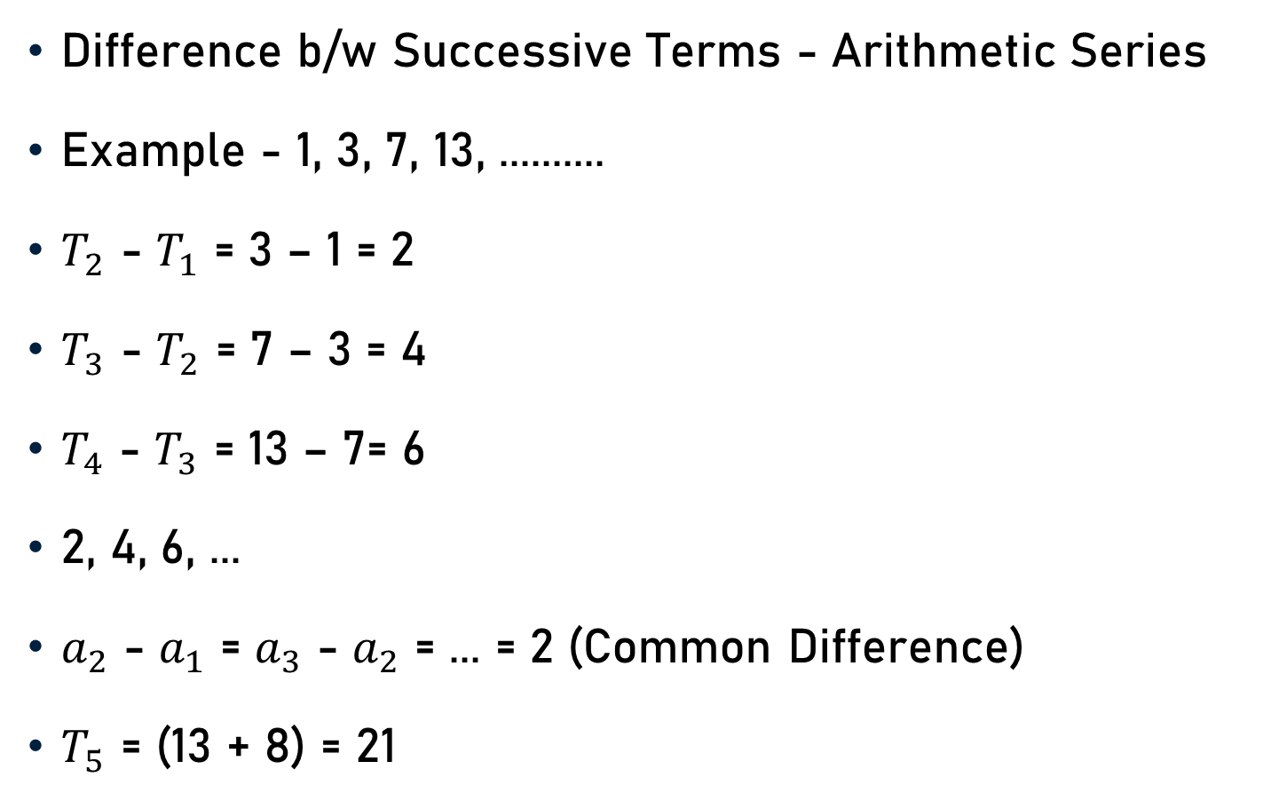
Arithmetic Series - Second Order
Difference b/w Successive Terms - Arithmetic Series
Example - 1, 3, 7, 13, ..........
$T_{2}$ - $T_{1}$ = 3 – 1 = 2
$T_{3}$ - $T_{2}$ = 7 – 3 = 4
$T_{4}$ - $T_{3}$ = 13 – 7= 6
2, 4, 6, ...
$a_{2}$ - $a_{1}$ = $a_{3}$ - $a_{2}$ = ... = 2 (Common Difference)
$T_{5}$ = (13 + 8) = 21

Slide 9
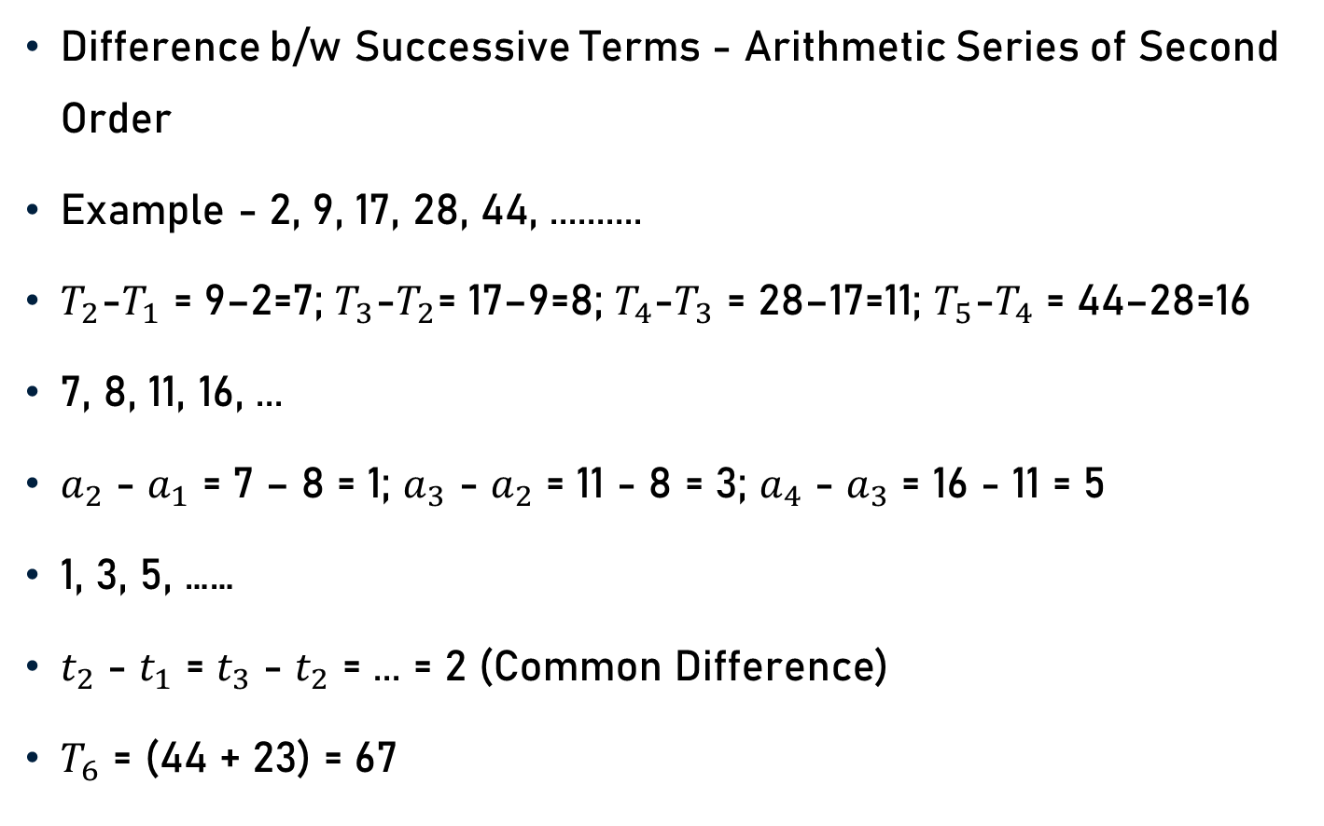
Arithmetic Series - Third Order
Difference b/w Successive Terms - Arithmetic Series of Second Order
Example - 2, 9, 17, 28, 44, ..........
$T_{2}$-$T_{1}$ = 9–2=7; $T_{3}$-$T_{2}$= 17–9=8; $T_{4}$-$T_{3}$ = 28–17=11; $T_{5}$-$T_{4}$ = 44–28=16
7, 8, 11, 16, ...
$a_{2}$ - $a_{1}$ = 7 – 8 = 1; $a_{3}$ - $a_{2}$ = 11 - 8 = 3; $a_{4}$ - $a_{3}$ = 16 - 11 = 5
1, 3, 5, ……
$t_{2}$ - $t_{1}$ = $t_{3}$ - $t_{2}$ = ... = 2 (Common Difference)
$T_{6}$ = (44 + 23) = 67

Slide 10
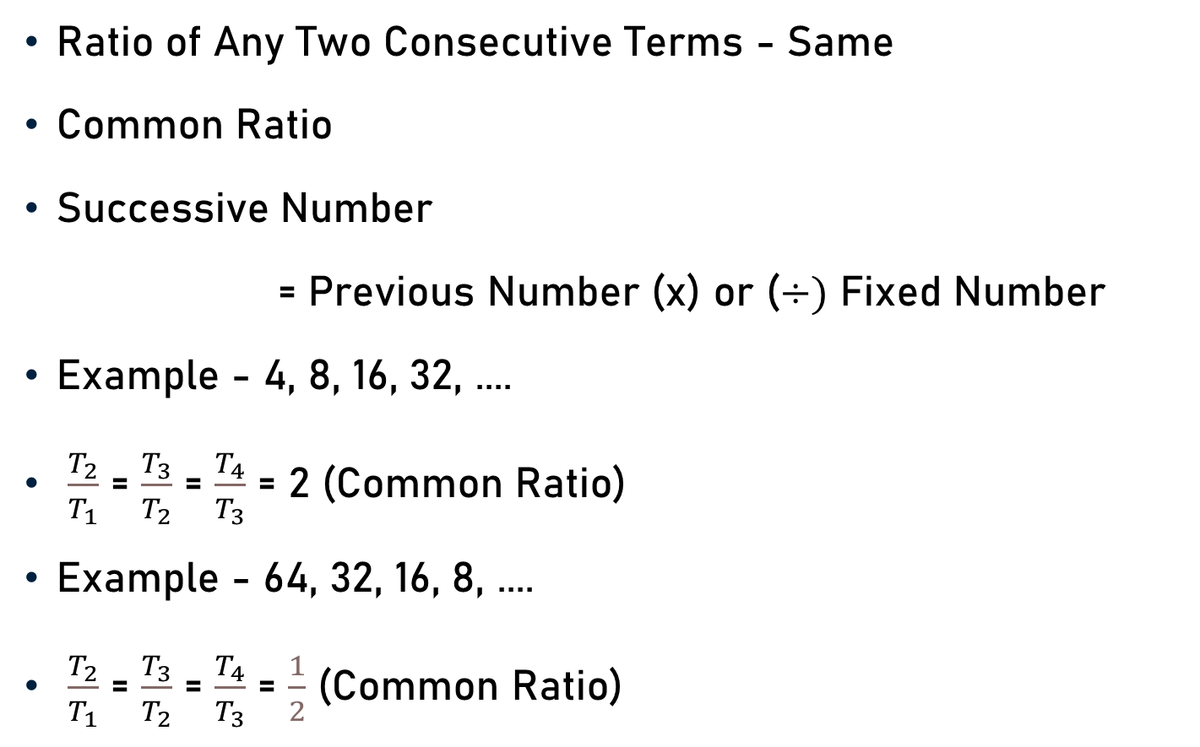
Geometric Series
Ratio of Any Two Consecutive Terms - Same
Common Ratio
Successive Number
= Previous Number (x) or ($÷)$ Fixed Number
Example - 4, 8, 16, 32, ....
$\frac{T_{2}}{T_{1}}$ = $\frac{T_{3}}{T_{2}}$ = $\frac{T_{4}}{T_{3}}$ = 2 (Common Ratio)
Example - 64, 32, 16, 8, ....
$\frac{T_{2}}{T_{1}}$ = $\frac{T_{3}}{T_{2}}$ = $\frac{T_{4}}{T_{3}}$ = $\frac{1}{2}$ (Common Ratio)

Slide 11
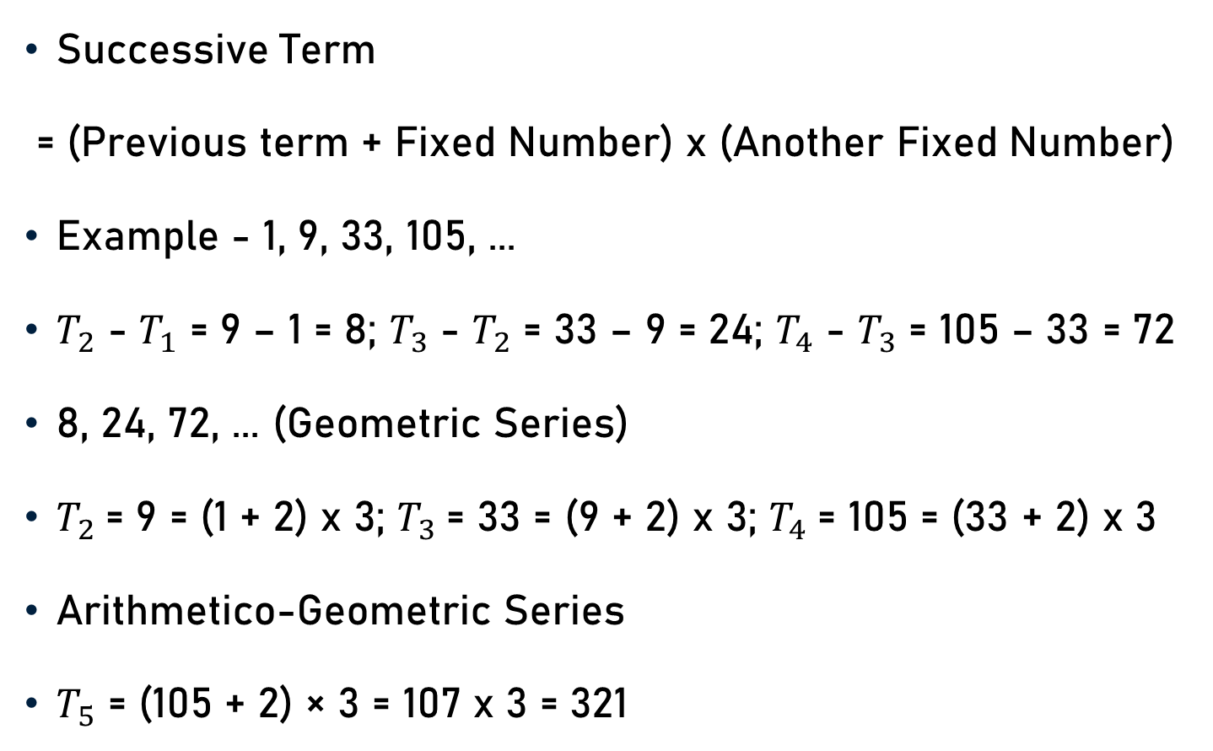
Arithmetico-Geometric Series
Successive Term
= (Previous term + Fixed Number) x (Another Fixed Number)
Example - 1, 9, 33, 105, ...
$T_{2}$ - $T_{1}$ = 9 – 1 = 8; $T_{3}$ - $T_{2}$ = 33 – 9 = 24; $T_{4}$ - $T_{3}$ = 105 – 33 = 72
8, 24, 72, ... (Geometric Series)
$T_{2}$= 9 = (1 + 2) x 3; $T_{3}$= 33 = (9 + 2) x 3; $T_{4}$= 105 = (33 + 2) x 3
Arithmetico-Geometric Series
$T_{5}$ = (105 + 2) × 3 = 107 x 3 = 321

Slide 12
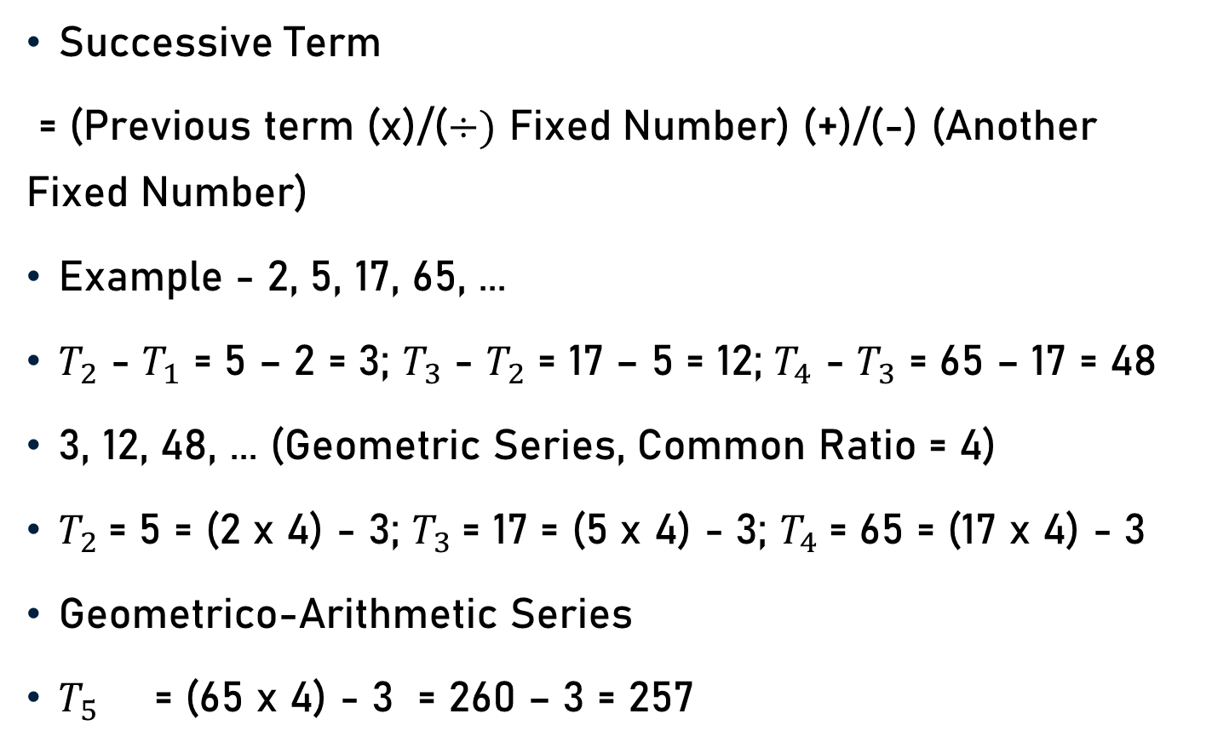
Geometrico-Arithmetic Series
Successive Term
= (Previous term (x)/($÷)$ Fixed Number) (+)/(-) (Another Fixed Number)
Example - 2, 5, 17, 65, ...
$T_{2}$ - $T_{1}$ = 5 – 2 = 3; $T_{3}$ - $T_{2}$ = 17 – 5 = 12; $T_{4}$ - $T_{3}$ = 65 – 17 = 48
3, 12, 48, ... (Geometric Series, Common Ratio = 4)
$T_{2}$= 5 = (2 x 4) - 3; $T_{3}$= 17 = (5 x 4) - 3; $T_{4}$= 65 = (17 x 4) - 3
Geometrico-Arithmetic Series
$T_{5}$ = (65 x 4) - 3 = 260 – 3 = 257

Slide 13
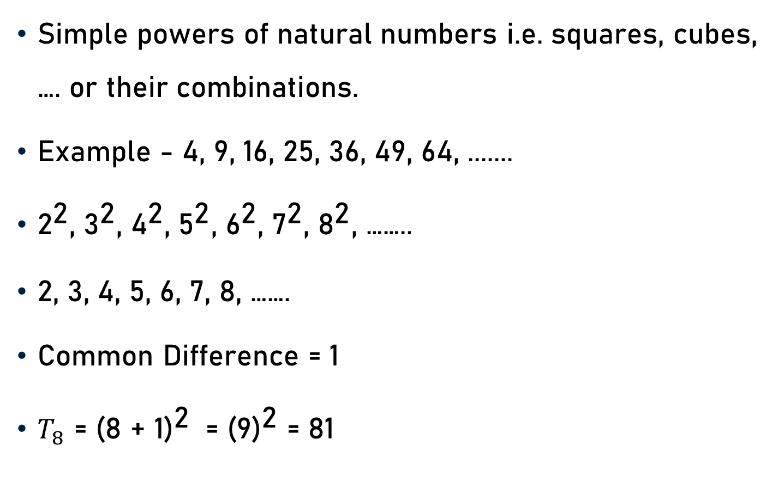
Series of Squares, Cubes …...
Simple powers of natural numbers i.e. squares, cubes, …. or their combinations.
Example - 4, 9, 16, 25, 36, 49, 64, .......
${\text{2}}^{\text{2}}$, ${\text{3}}^{\text{2}}$, ${\text{4}}^{\text{2}}$, ${\text{5}}^{\text{2}}$, ${\text{6}}^{\text{2}}$, ${\text{7}}^{\text{2}}$, ${\text{8}}^{\text{2}}$, ……..
2, 3, 4, 5, 6, 7, 8, …….
Common Difference = 1
$T_{8}$ = ${\text{(}\text{8}\text{ + 1)}}^{\text{2}}$ = ${\text{(}\text{9}\text{)}}^{\text{2}}$ = 81

Slide 14

Series of Squares, Cubes …...
Example - $\frac{\text{1}}{\text{8}}$, $\frac{\text{4}}{\text{27}}$, $\frac{\text{9}}{\text{64}}$, $\frac{\text{16}}{\text{125}}$, $\frac{\text{25}}{\text{216}}$, ………
$\frac{{\text{1}}^{\text{2}}}{{\text{2}}^{\text{3}}}$, $\frac{{\text{2}}^{\text{2}}}{{\text{3}}^{\text{3}}}$, $\frac{{\text{3}}^{\text{2}}}{{\text{4}}^{\text{3}}}$, $\frac{{\text{4}}^{\text{2}}}{{\text{5}}^{\text{3}}}$, $\frac{{\text{5}}^{\text{2}}}{{\text{6}}^{\text{3}}}$, ………
$\frac{{\text{n}}^{\text{2}}}{{\text{(}\text{n}\text{+1)}}^{\text{3}}}$
$T_{6}$ = $\frac{{\text{6}}^{\text{2}}}{{\text{7}}^{\text{3}}}$ = $\frac{\text{216}}{\text{343}}$

Slide 15
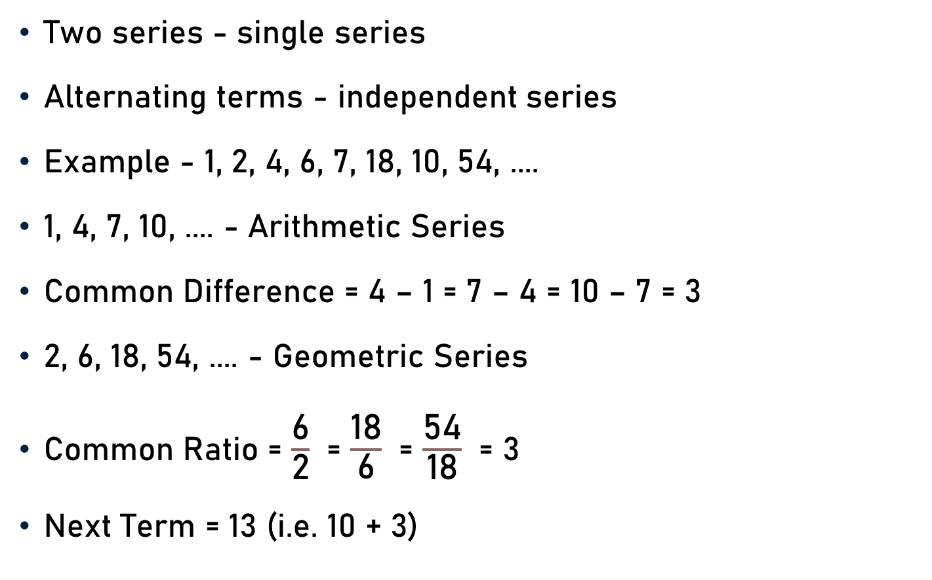
Double Series
Two series - single series
Alternating terms - independent series
Example - 1, 2, 4, 6, 7, 18, 10, 54, ....
1, 4, 7, 10, .... - Arithmetic Series
Common Difference = 4 – 1 = 7 – 4 = 10 – 7 = 3
2, 6, 18, 54, .... - Geometric Series
Common Ratio = $\frac{\text{6}}{\text{2}}$ = $\frac{\text{18}}{\text{6}}$ = $\frac{\text{54}}{\text{18}}$ = 3
Next Term = 13 (i.e. 10 + 3)

Slide 16
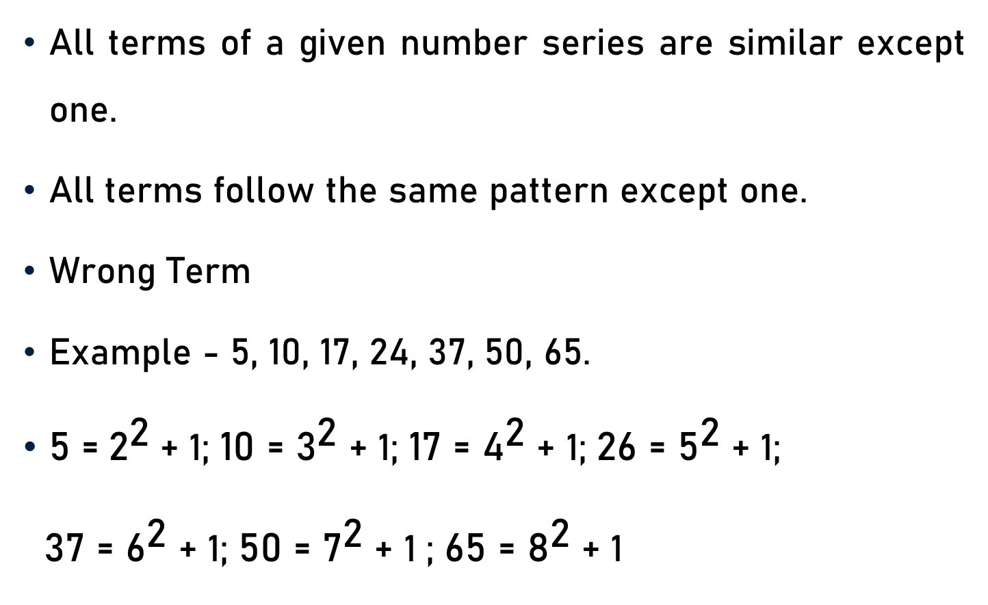
Finding Wrong Term - Series
All terms of a given number series are similar except one.
All terms follow the same pattern except one.
Wrong Term
Example - 5, 10, 17, 24, 37, 50, 65.
5 =${ \text{2}}^{\text{2}}$+ 1; ${\text{10 }\text{=}\text{ 3}}^{\text{2}}$ + 1; ${\text{17 }\text{=}\text{ 4}}^{\text{2}}$ + 1; 26 = ${\text{5}}^{\text{2}}$ + 1;
${\text{37 }\text{=}\text{ 6}}^{\text{2}}$ + 1; ${\text{50 }\text{=}\text{ 7}}^{\text{2}}$ + 1 ; ${\text{65 }\text{=}\text{ 8}}^{\text{2}}$ + 1

Slide 17
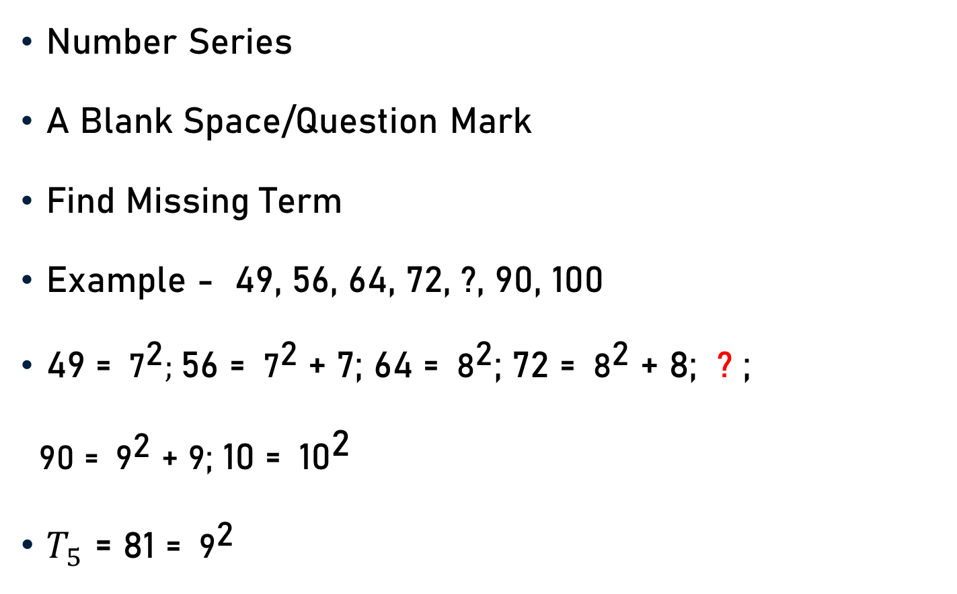
Finding Missing Term - Series
Number Series
A Blank Space/Question Mark
Find Missing Term
Example - 49, 56, 64, 72, ?, 90, 100
49 = ${ \text{7}}^{\text{2}};$56 = ${ \text{7}}^{\text{2}}$ + 7; 64 = ${ \text{8}}^{\text{2}}$; 72 = ${ \text{8}}^{\text{2}}$ + 8; ? ;
90 = ${ \text{9}}^{\text{2}}$ + 9; 10 = ${ \text{10}}^{\text{2}}$
$T_{5}$ = 81 = ${ \text{9}}^{\text{2}}$

Slide 18
Types of Special Series
Series of Date/Time
Numbers followed by their L.C.M. or H.C.F
Numbers Followed by their Product
By Use of Digit Sum

Slide 19
Series of Date/Time
Example-
  3 - 9 - 2022, 13 - 9 - 2022, 23 - 9 - 2022, & 2 - 10 – 2022.
  Differs by 10 days.
  September, 2022 - 30 days
  2 - 10 - 2004 replaced by 3 - 10 – 2022
Example –
  1:00, 2:25, 3:40, 5:15, 6:40
  Difference - 1 hour 25 min.
  3:40 should be replaced by 3:50.

Slide 20
Numbers Followed by Their L.C.M. or H.C.F
Example - 1, 2, 3, 6, 4, 5, 6, 60, 5, 6, 7, ?
  L.C.M. of 1, 2 & 3 = 6
  L.C.M. of 4, 5 & 6 = 60
  L.C.M. of 5, 6 & 7 = 210
Example - 8, 4, 4, 7, 8, 1, 3, 9, 3, 2, 1, ?
  H.C.F. of 8 and 4 = 4
  H.C.F. of 7 and 8 = 1
  H.C.F. of 3 and 9 = 3
  H.C.F. of 2 and 1 = 1

Slide 21
Numbers Followed by Their Product
Example - 1, 3, 3, 9, 27, 243, ?
1 = 1
1 × 3 = 3
3 × 3 = 9
3 × 9 = 27
9 × 27 = 243
Next Number = Product of Previous Two Numbers
Next Number = 27 × 243 = 6561

Slide 22
Use of Digit Sum
Example - 11, 13, 17, 25, 32, ?
13 = 11 + (1 + 1)
17 = 13 + (1 + 3)
25 = 17 + (1 + 7)
32 = 25 + (2 + 5)
Next Number =
  Previous Number + Sum of the digits of pervious number
Next Number = 32 + (3 + 2) = 37

Slide 23
Alpha–Numeric Series
Letters & Numbers
Two-line Series - Number Series & Alphabet Series
Same Pattern/Rule
Example - 2, 7, 17, 37, 77,
3, a, b, c, d,
7 = 2 x 2 + 3; 17 = 7 x 2 + 3; 37 = 17 x 2 + 3; 77 = 37 x 2 + 3
a = 3 x 2 + 3 = 9; b = 9 x 2 + 3 = 21; c = 21 x 2 + 3 = 45;
d = 45 x 2 + 3 = 93

Slide 24
Conclusion
Sequence
  Set of Numbers
  Definite Order/Rule
Series
  Sequence of Numbers
  Predefined Rule

Slide 25
Conclusion
Number Series
  Arithmetic Series
  Arithmetic Series – Second Order
  Arithmetic Series – Third Order
  Geometric Series
  Arithmetico-Geometric Series
  Geometrico-Arithmetic Series
  Series of Squares, Cubes, …..

Slide 26
Conclusion
Some Special Series
  Series of Date/Time
  Numbers followed by their L.C.M. or H.C.F
  Numbers Followed by their Product
  By Use of Digit Sum
Alpha–Numeric Series

Slide 27
Summary
Sequence
Series
Type of Series

